Slide 1


Slide 2


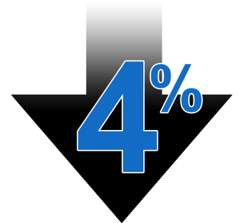
Problem
Overall financial health and lack of saving within America.
41% of Millennials are ‘Chronically Stressed” about money.
Not saving enough
Spending more than they should
57% of Americans have difficulty managing finances (138 million)
46% of adults could not cover an emergency expense costing $400.
Average savings rate of disposable income is less than 4%

Slide 3
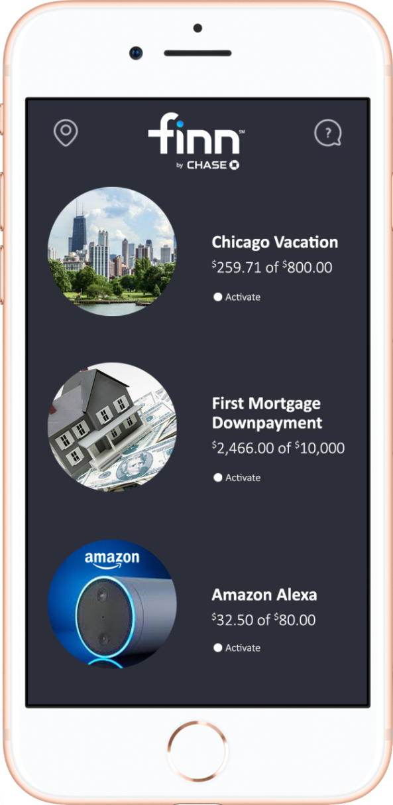
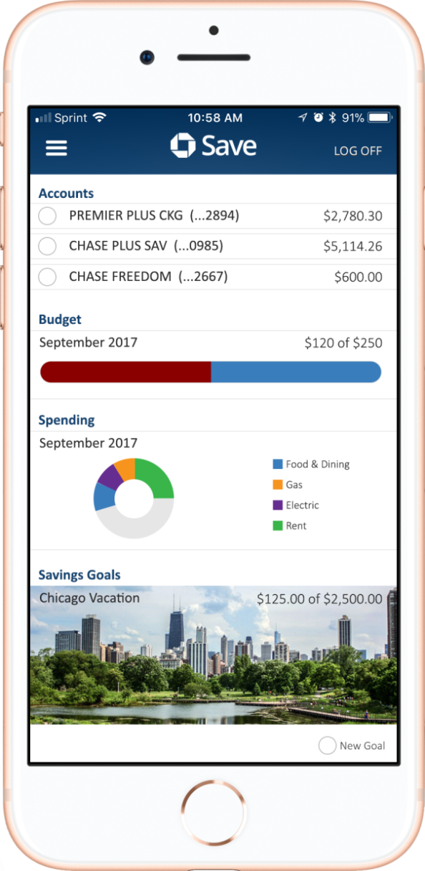
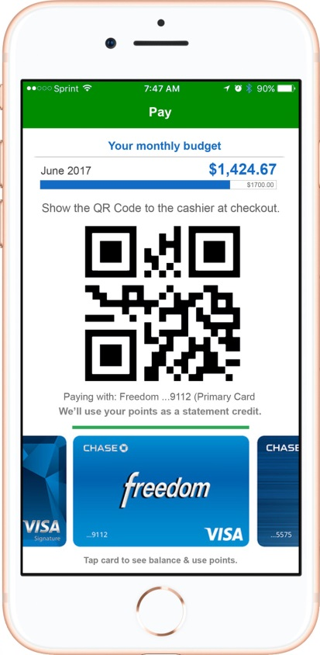



Solution

Slide 4
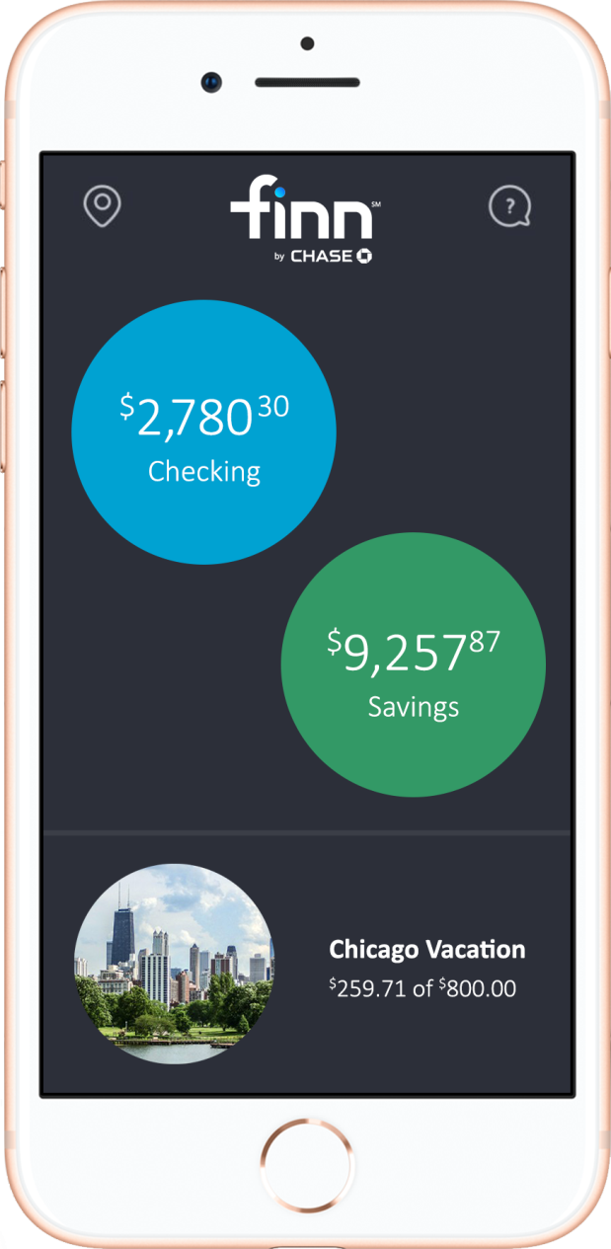
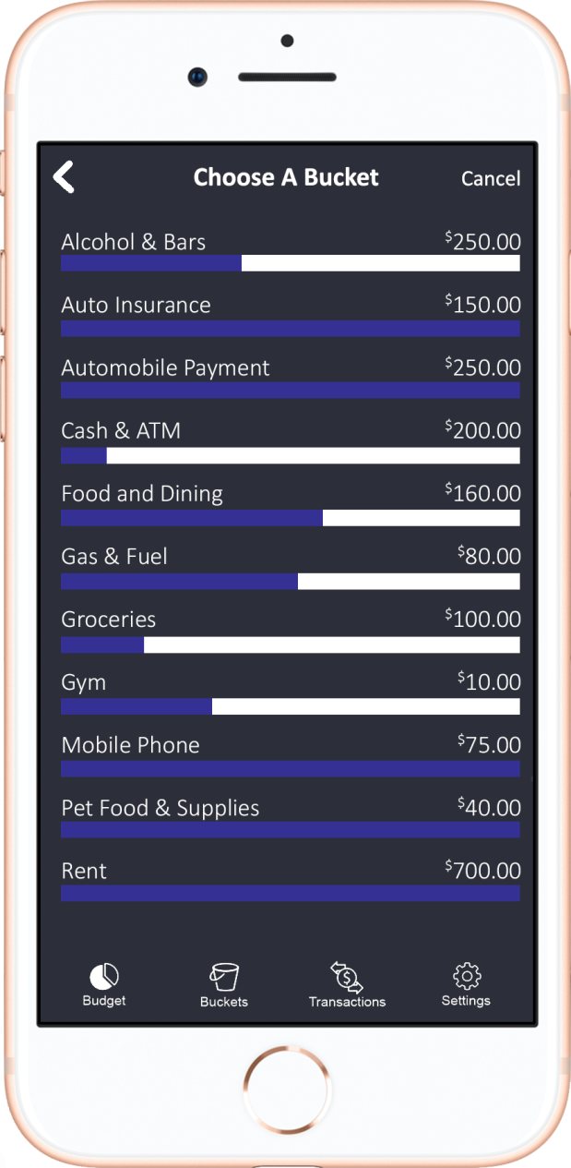
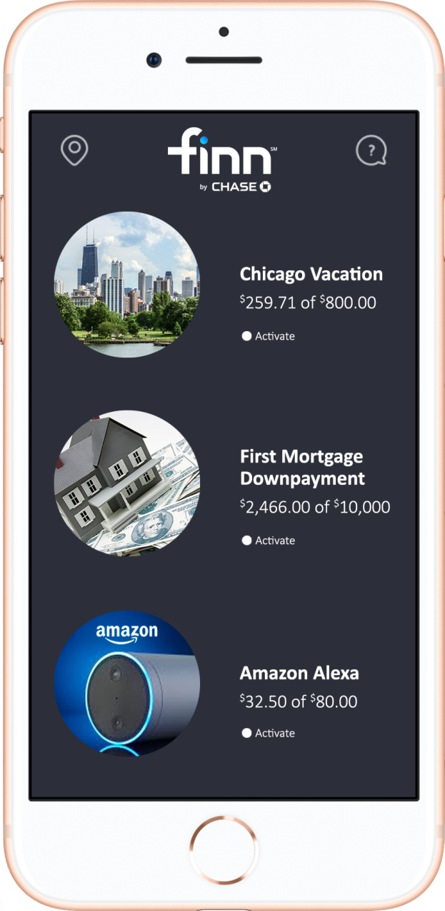
Finn + Chase Save Integration

Slide 5
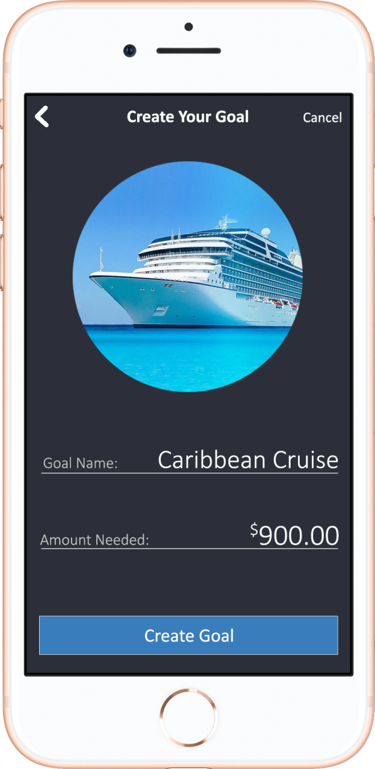
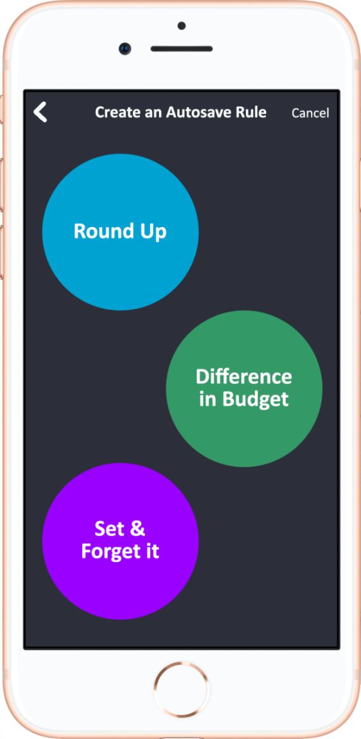
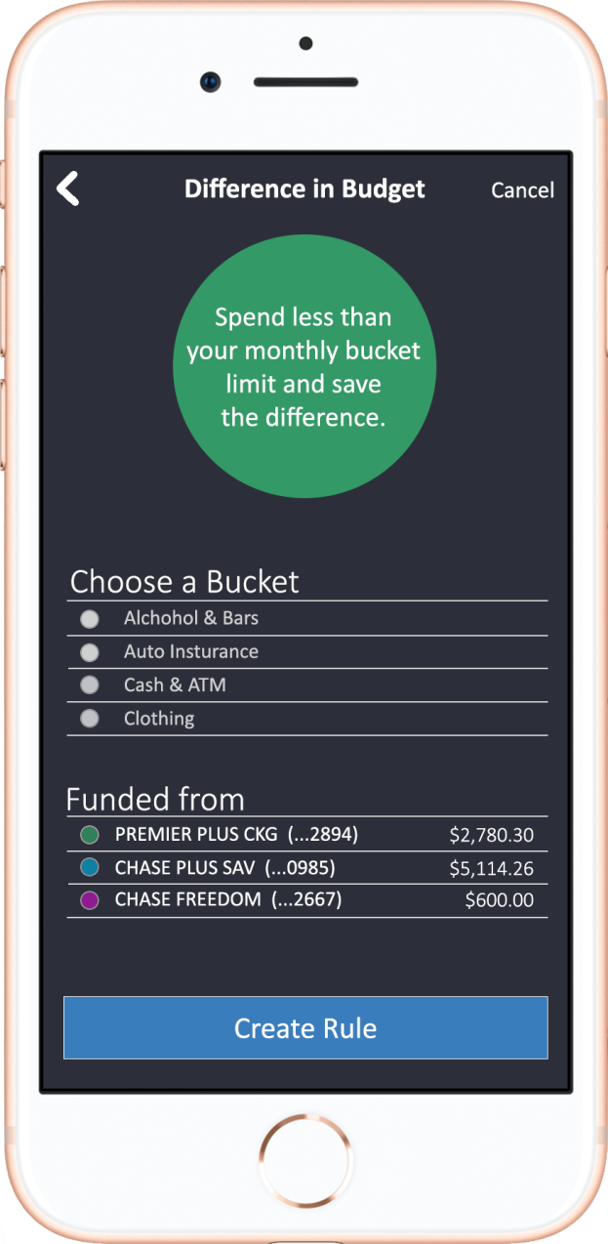
Rules for goals

Slide 6










Competition
Saving
Budgeting
Investing

Slide 7
Market Opportunity
First company to incorporate dynamic budgeting and saving platforms into a single banking application.
First digital payment platform to integrate budgeting and saving capabilities and allow for real-time financial awareness directly after the point of sale
138 million Americans struggle with financial health
Chase Mobile has 29.3 million active users, and 45.9 million when including desktop users.
Create revenue streams by funneling savings into chase featured products or 3rd party products

Slide 8
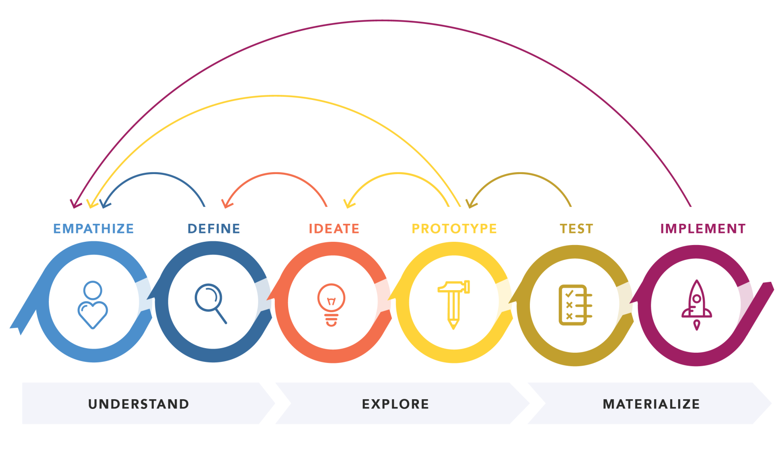
Experimental approach to product development

Slide 9
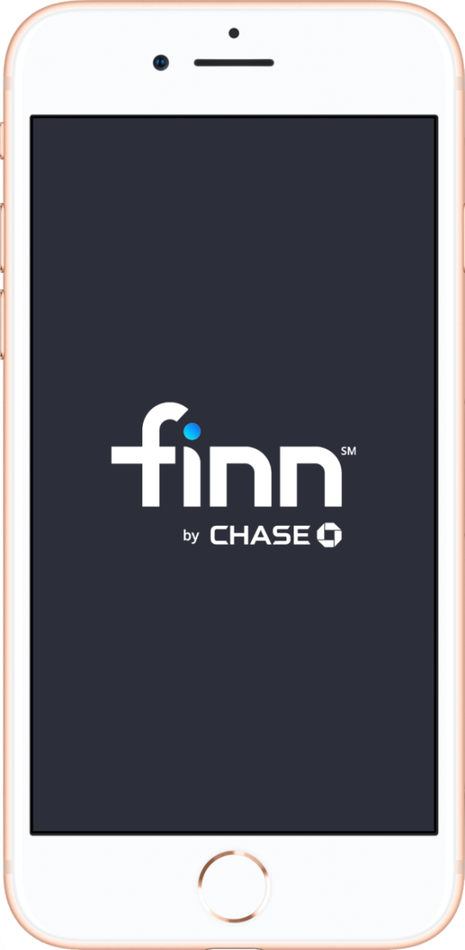
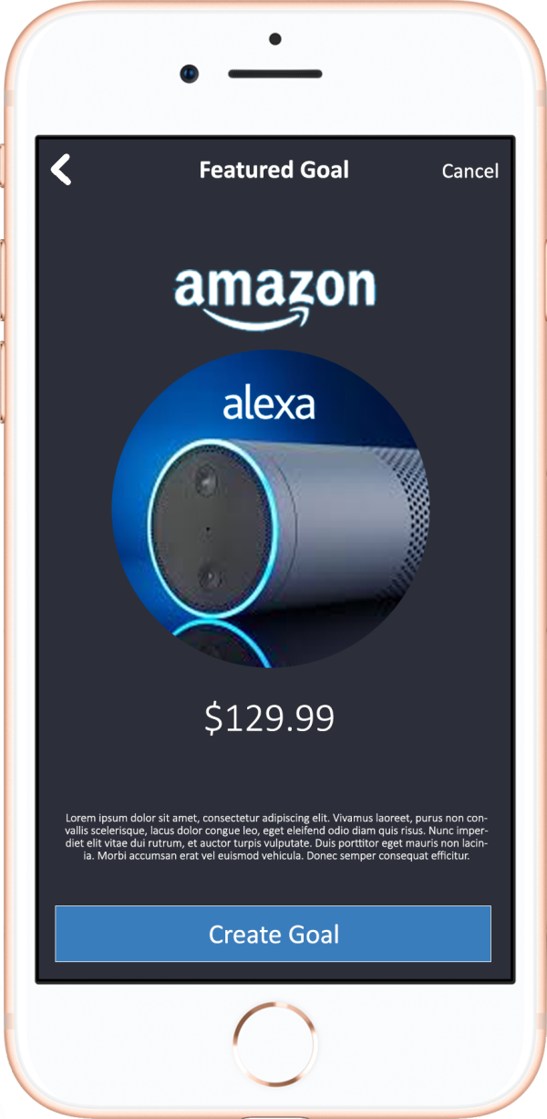
Road Map: Integrate with Finn

Slide 10
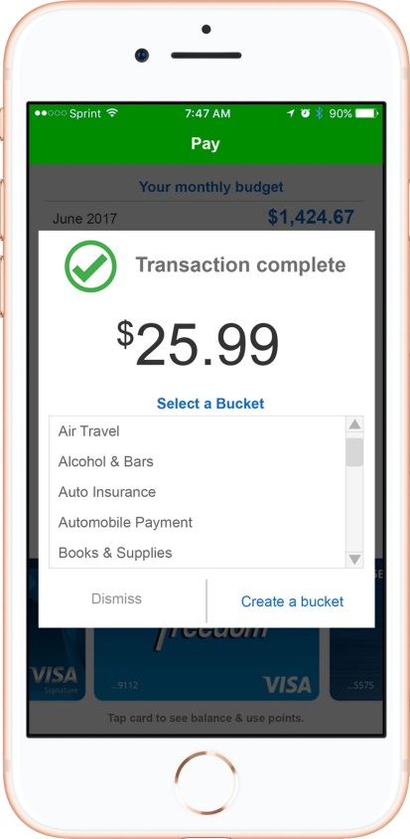
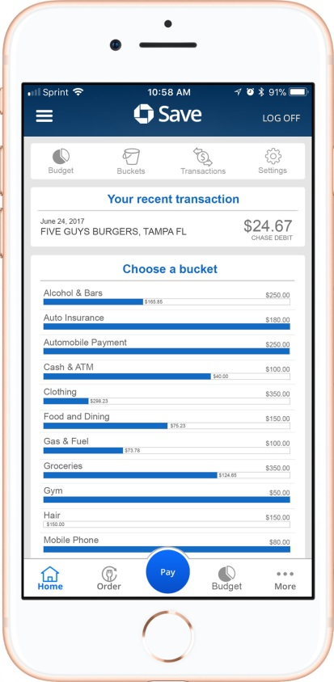
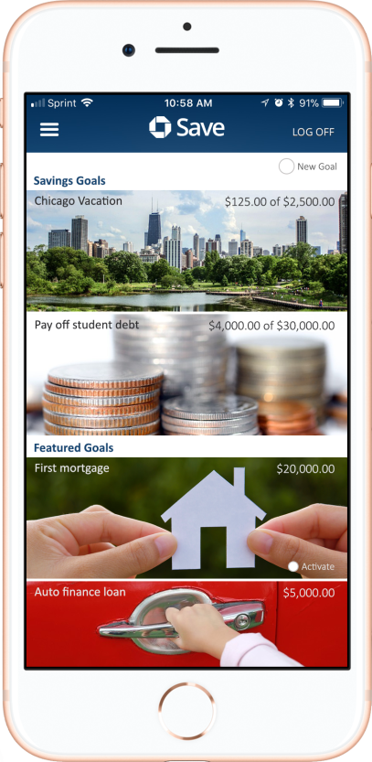
Road Map: Integrate with Chase Pay

Slide 11
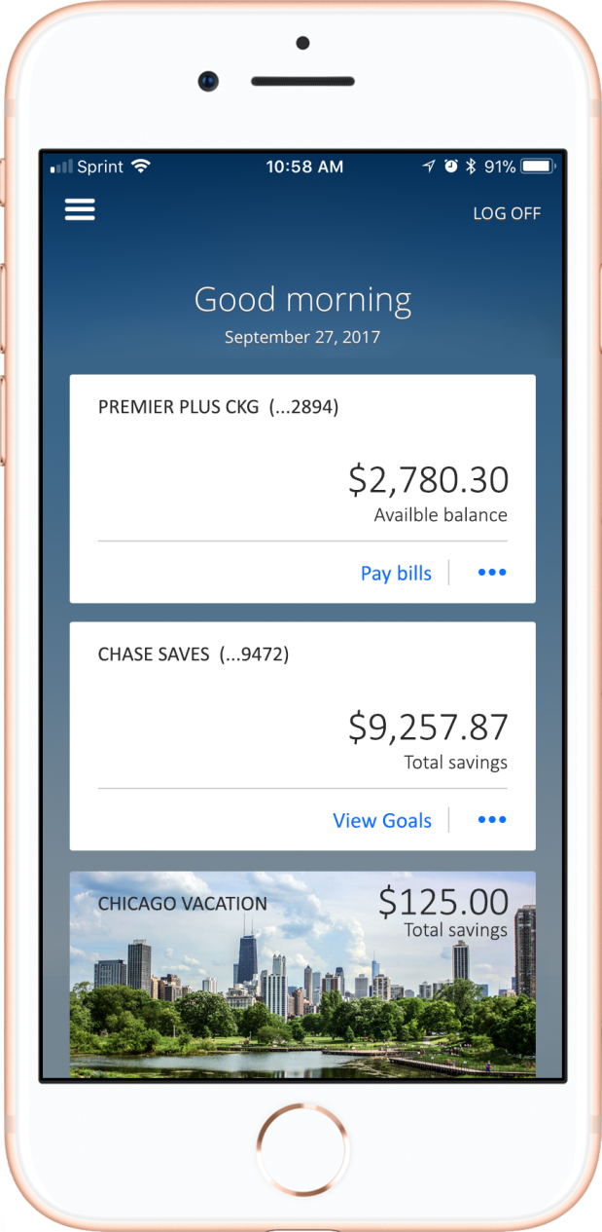
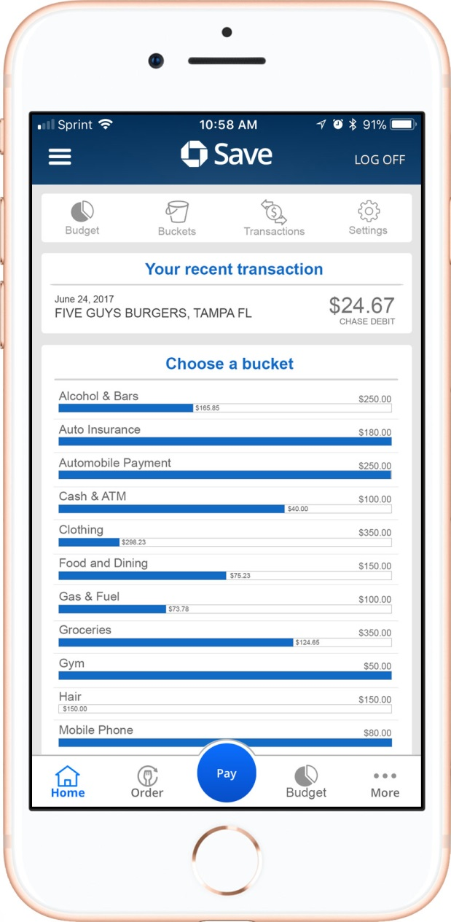
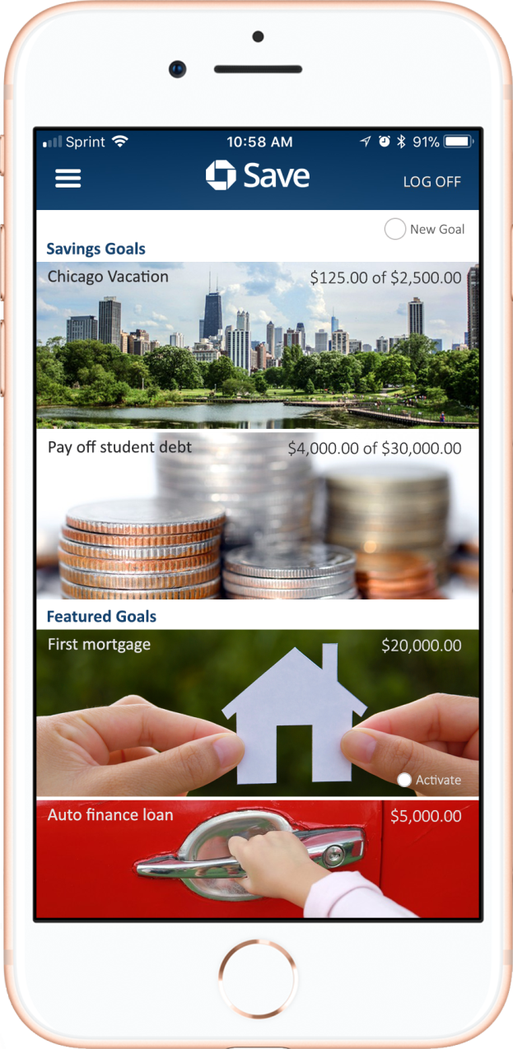
Road Map: Integrate with Chase Mobile

Slide 12
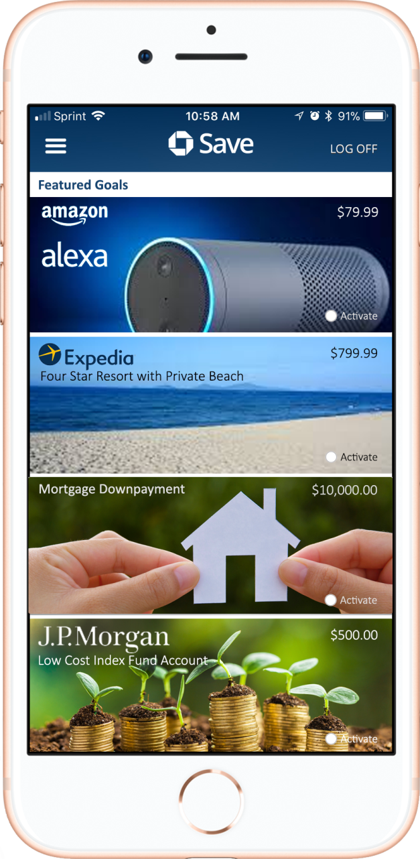
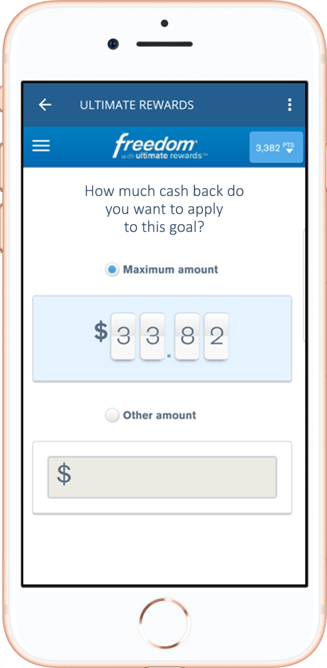
Savings-first marketplace
3rd Party Products
Fund goals with cashback
+ credit card pts
Investment Services

Slide 13
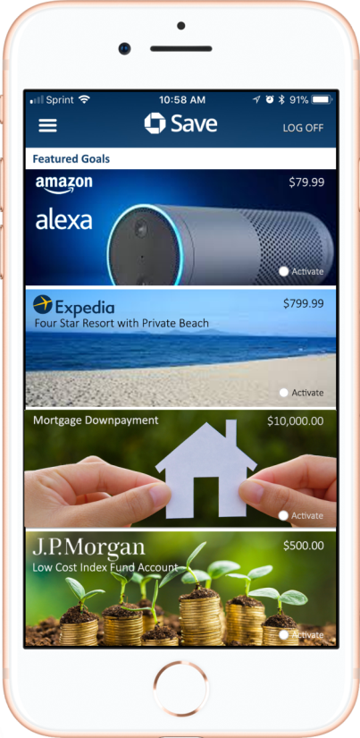

Future Road Map
New market place by setting savings goals to
Feature Chase products
Feature 3rd party product offerings
Feature future Chase investment account services
Credit Card reward integration
Integrate with Chase Payment Platforms
Use data analytics and machine learning to
Provide budget/spending advice to consumers
Create a platform for merchants to create personalized product offerings

Slide 14
THANK YOU!
David Deveney
Software Engineer
Merchant Services
J.P. Morgan 4915 Independence Parkway, Floor 03 Tampa, FL, 33634
1-813-302-4656

